Slide 1

DEFRAGGING
TEXTUAL ANALYSIS
Tools and Tips for the Qualitative Study of Play

Slide 2
Method
Documentation
Analysis

Slide 3
Close-readings are formal readings, in other words, they focus on the artwork rather than its readers or the cultural context in which the artwork emerged. They are carefully constructed, well-argued and sustained readings of texts. The term is closely connected to the emergence of new criticism.

Slide 4
Games are transmedial objects that have many layers. Reading their medium-specific properties means paying attention to scripts, code, rules, but also to sound, visuals (character and level designs) or embedded movies.
Games are performances, but can also be understood through their cinematography, sound design or storytelling.

Slide 5
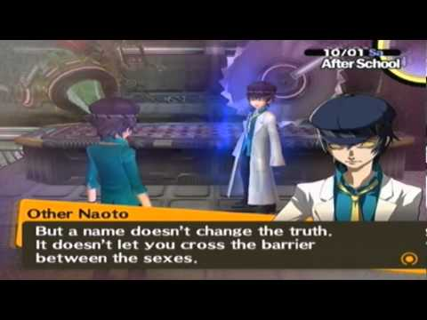
Youngblood 2013 – queer reading of Persona 4

Slide 6
Close-readings are diverse. For instance, games can be viewed through the lense of procedural rhetorics (Bogost) as rule-driven texts; be performances (Nitzsche) or simulations (Frasca) or worlds.
Such concepts can inform the kind of close-reading that you conduct and how you demarcate the game as an object.

Slide 7
Close-readings of games or game tropes may even focus particularly on representations/mediations of gaming, rather than the games themselves.

Slide 8
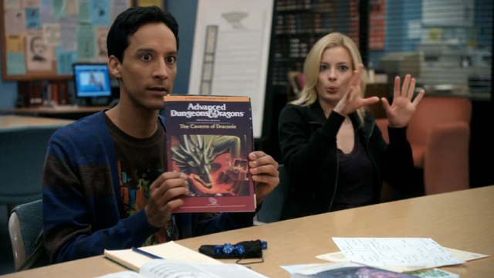

Slide 9
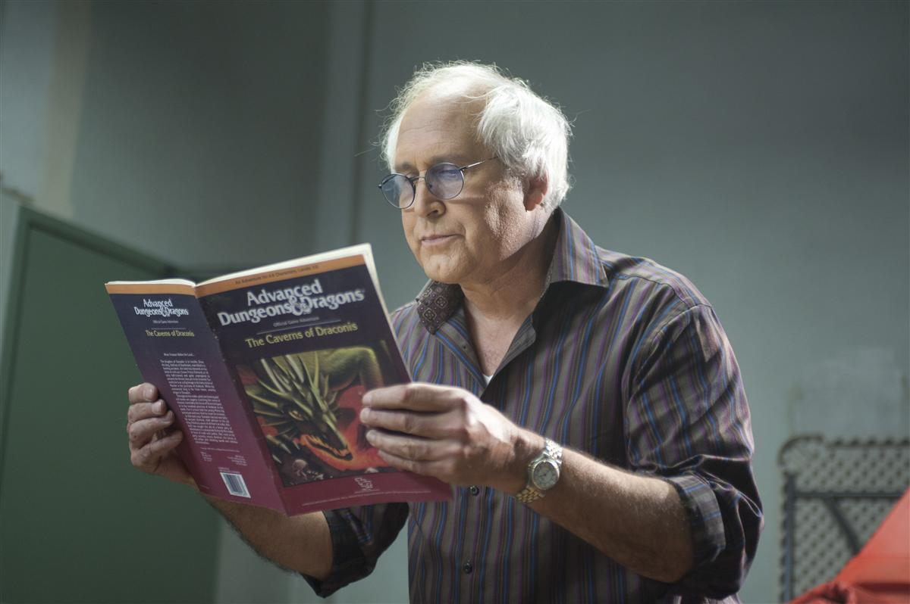

Slide 10
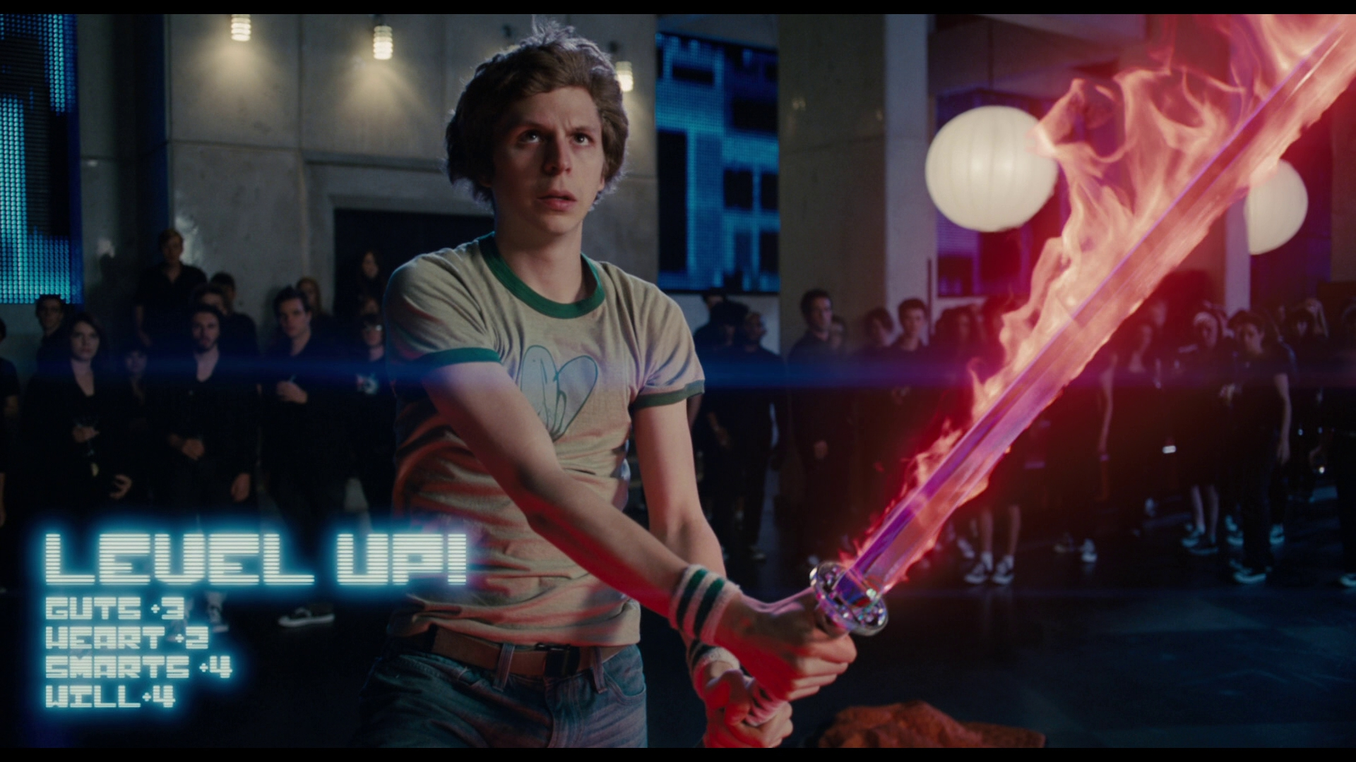

Slide 11
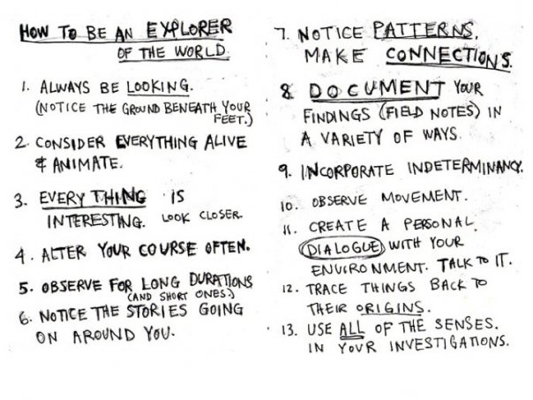

Slide 12
If possible: record your game play as fully as possible so you can rewatch it. Screenshots will help you remember the important moments too.
In traditional games, recording may not even be possibly. It may hinder the other players, the room may be noisy and ethics are involved. (Ask for permission to record!)

Slide 13
Always consider rudimentary but important things like drawing a map of the space, or a flow chart of the levels, making notes of who participates, what objects are involved/props
Don’t forget costumes/attires/mise-en-scene or notes on sound/music. Some of these can be done after the initial playthrough, which is why visual documentation is so important

Slide 14
FRAPS
OPEN BROADCAST SOFTWARE

Slide 15
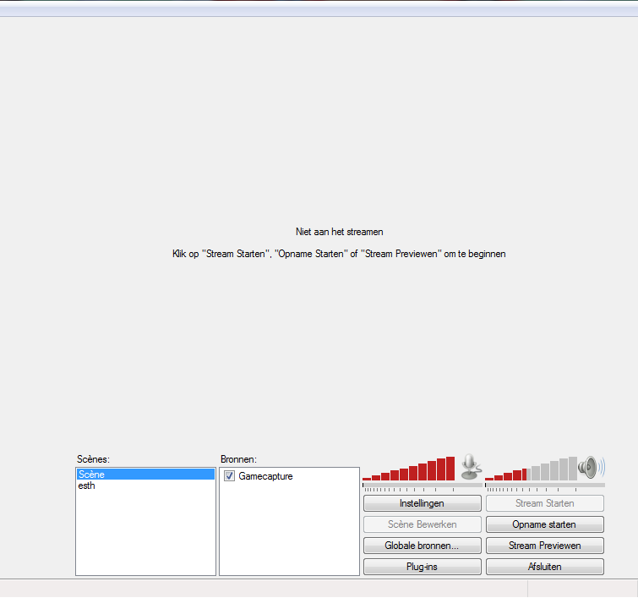
1. Tinker with options. Resolution should be same as your monitor

Slide 16
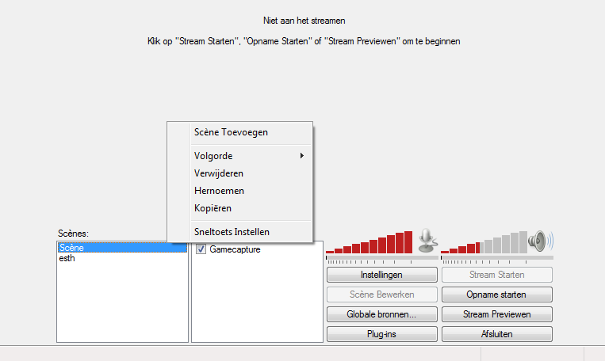
2. Add a scene

Slide 17
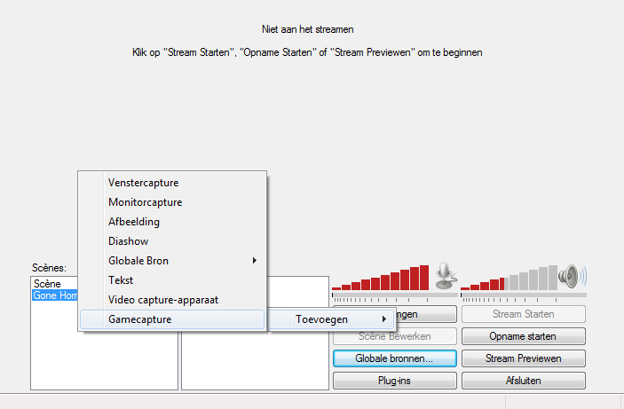
3. Add a source with game capture (right click in sources box, add source)
Tip: Adding to individual scenes is easier than via global sources

Slide 18
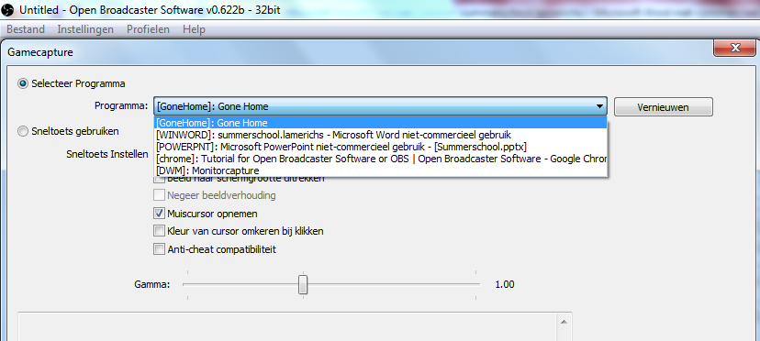
4. Select program/game (or open game and press renew) and assign hotkey

Slide 19
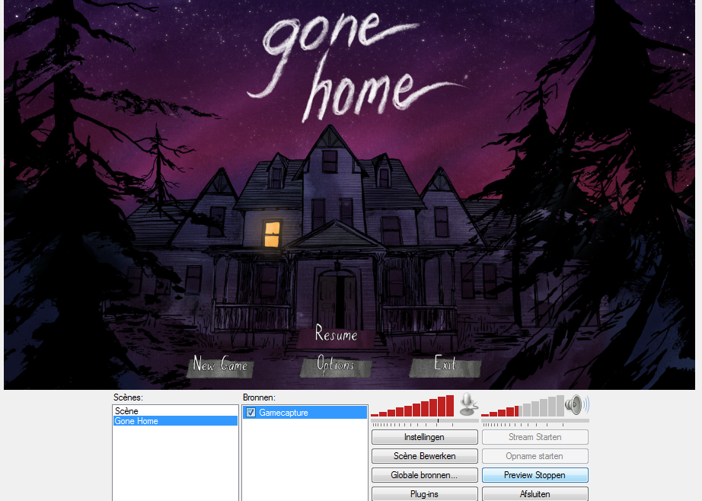
5. Admire preview to see if everything is okay and start recording

Slide 20
A research diary will help you document your initial thoughts and findings. Reflect on your game play experiences, write down observations and parts of the dialogue, take screenshots or photographs.
Depending on your project, you may also want to store literature summaries, conference notes and other thoughts related to your project.

Slide 21
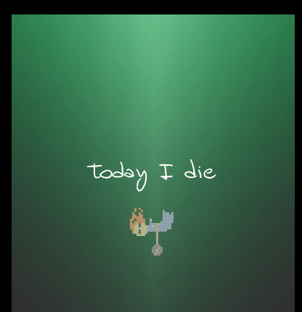
Today I Die

Slide 22
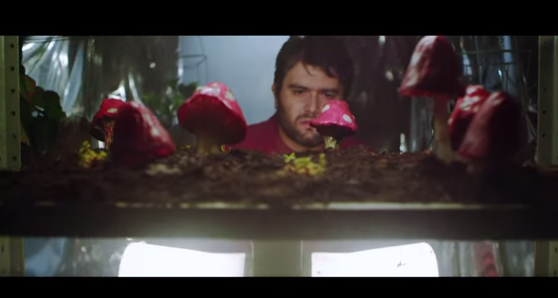
The Four Players

Slide 23
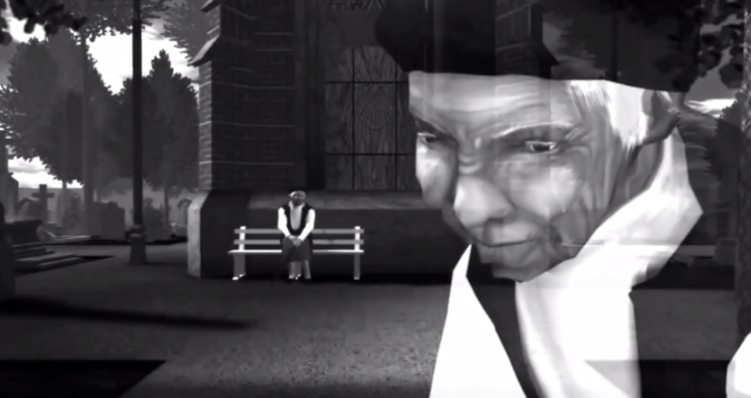
The Graveyard

